Slide 1


Slide 2
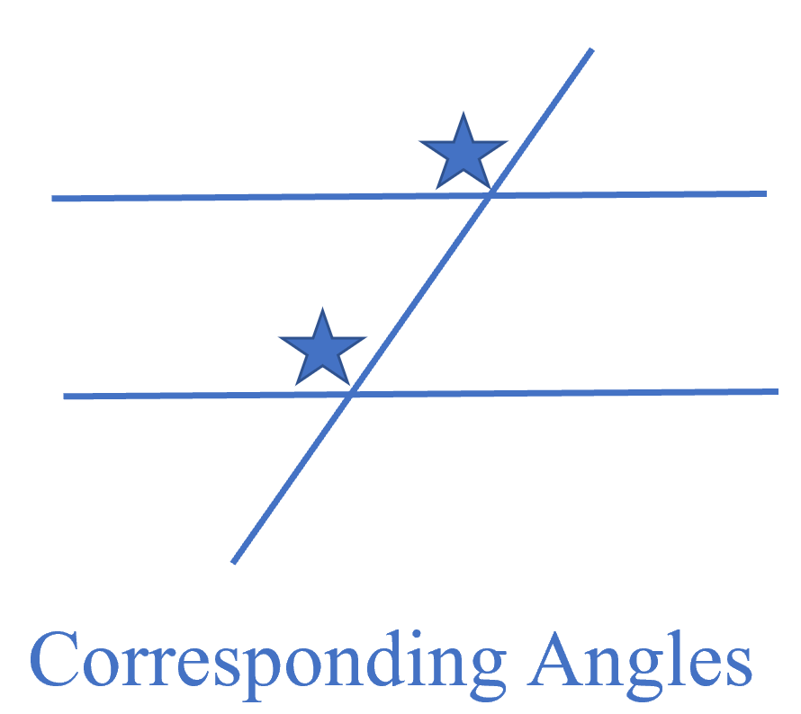

Slide 3
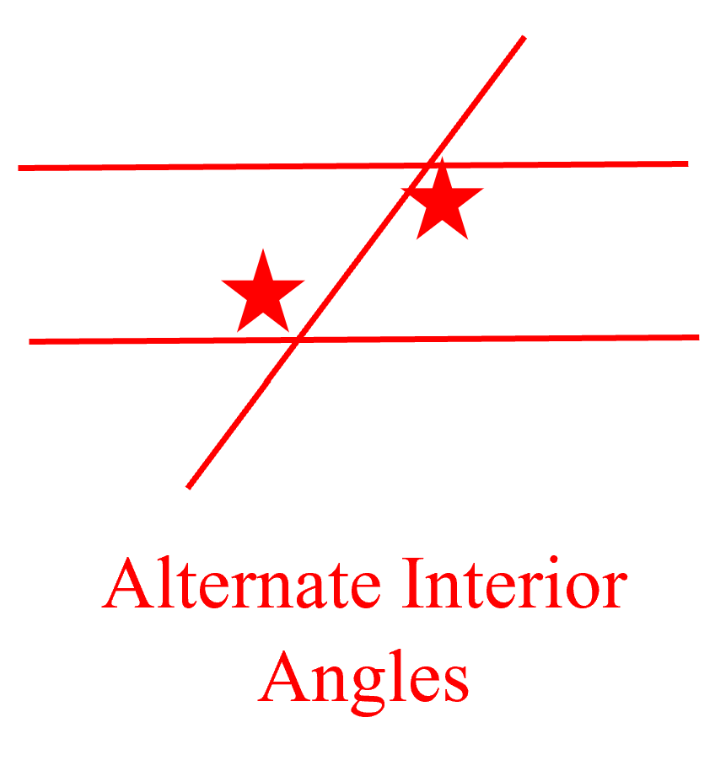

Slide 4
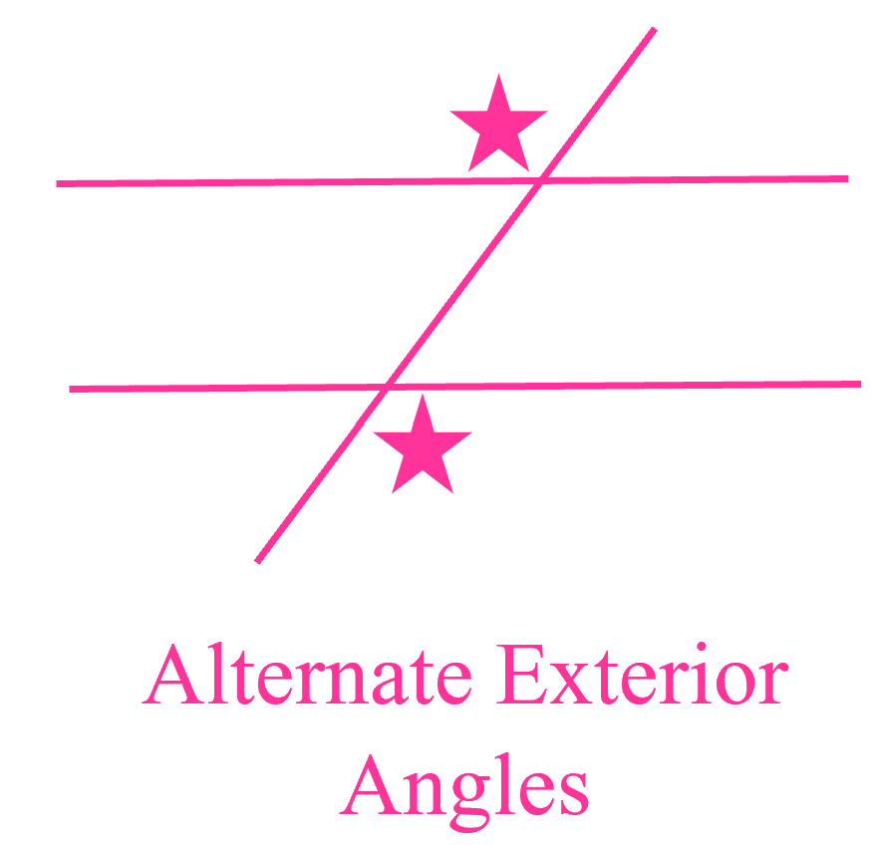

Slide 5
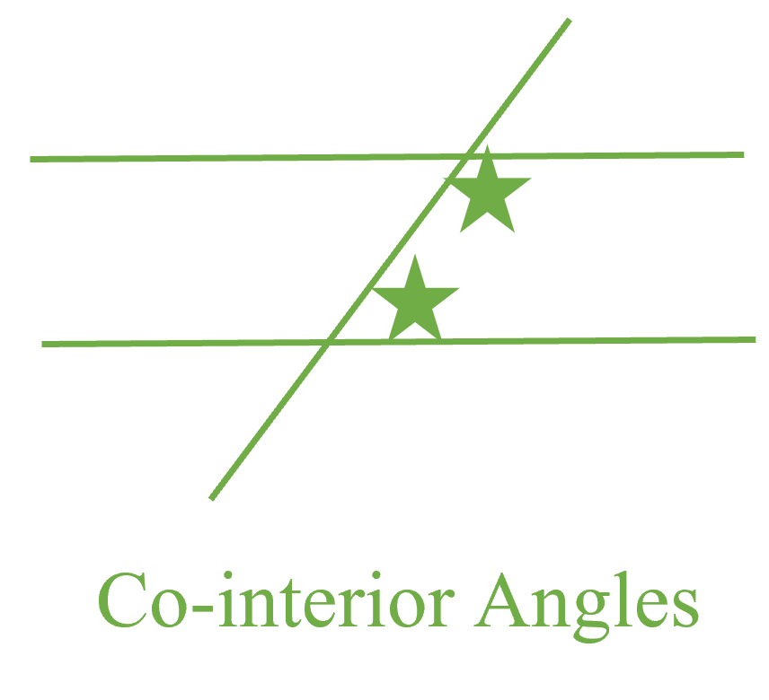

Slide 6
Vertical Angles

Slide 7
How to play
The dance moves (the angles) will move up the screen.
As the dance move enters the box you have to “do” that move, by putting your feet where the stars are.
The team that is judged to do the most correct dance moves wins the round.

Slide 8
Round One
Tones and I
Dance Monkey

Slide 9

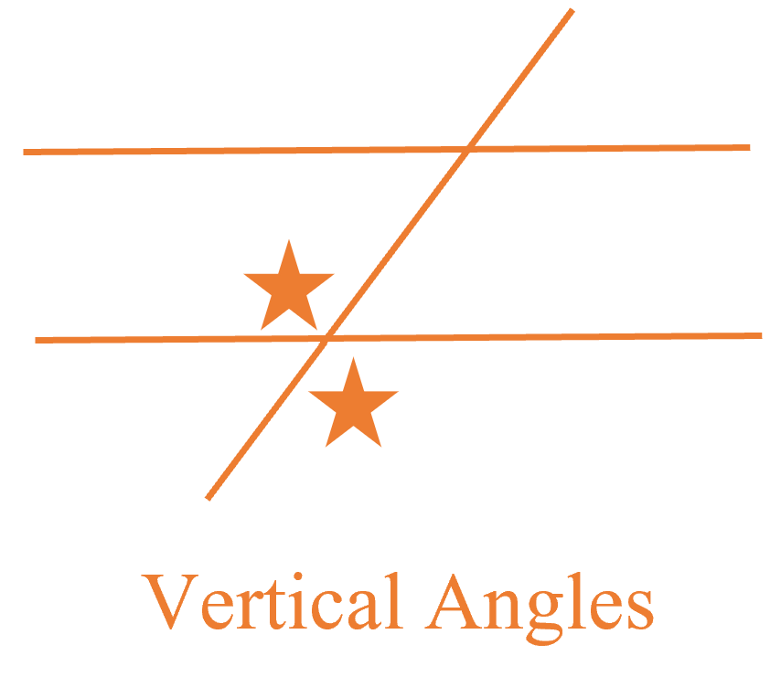
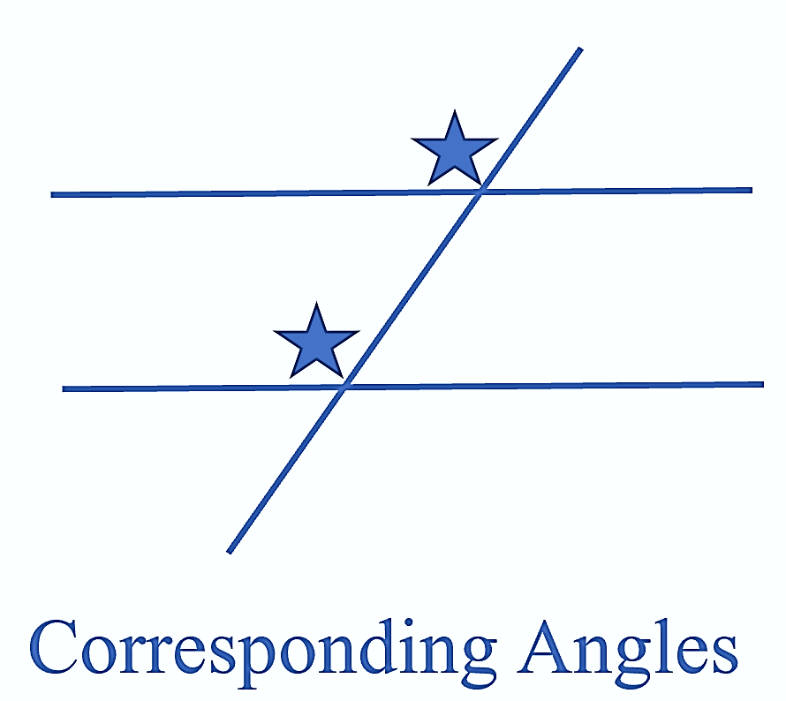

Slide 10
Round Two
Uptown Funk
Mark Ronson & Bruno Mars

Slide 12
Round Three
High Hopes
Panic! At the Disco

Slide 14
Round Four
Blinding Lights
The Weeknd

Slide 16
Round Five
Shup Up and Dance With Me
Walk The Moon

